Slide 1
Student Mental Wellness

Slide 2
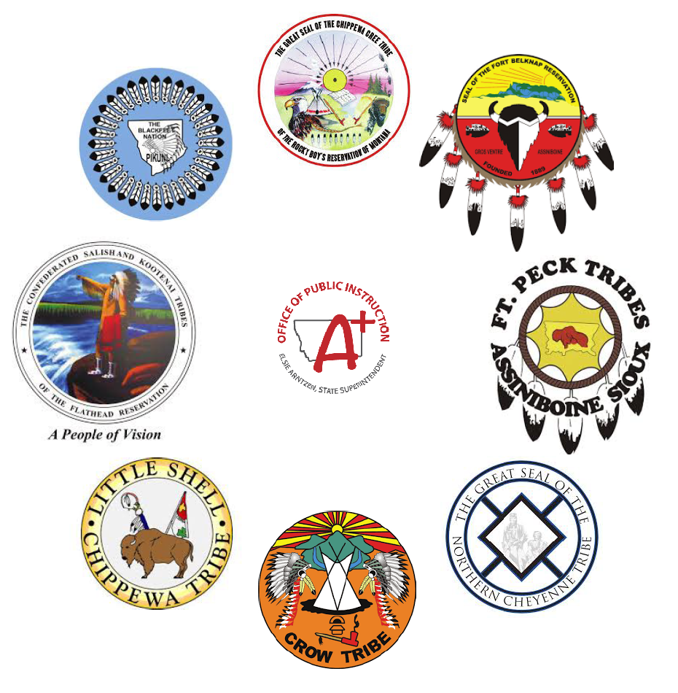
Tribal Relations & Resiliency
Established
Mission
Vision
Staff
Initiatives
Notes:
Winter 2020: The Tribal Liaison position was developed to build better inclusion of indigenous voice and understandings within the Office of Public Instruction (OPI) and Montana school districts to incorporate Tribal Voice & practices from the experience. Covid hit and we closed out our grants and looked to the future. Winter 2022 the TRR Unit began to develop with the mission to seek guidance from our tribal nations while providing support for mental health, language, culture, tribal outreach, school board support, youth inclusion and connections through consultation on matters affecting American Indian students. Establishing Consultation, defined within ESSA requirements to create opportunities for school districts and tribal leaders to work collaboratively for the benefit of our youth. September 2022 our full team was finally in place as we received grant funds ad ESSER funds to support our vision. We have an excellent opportunity to re-envision our educational systems in Indian country from Indian Country. We’ve evolved to work on holistic supports while incorporating the culture and self-identity from the indigenous source through the KKIN. We progress, never look back and will always emphasize the resiliency, wisdom and beauty of our indigenous people at every level within our work with districts and the State.

Slide 3
The State of Mental Wellness
Voice of youth and tribal communities
YRBS Data
Ongoing gathering of available data to inform work
Notes:
Voice of youth and tribal communities
The Tribal Relations and Resiliency Unit has been informed by the voice of our tribal youth, leaders, and stakeholders since long before the unit was established. In 2013 the Tribal Wraparound Project was implemented as a behavioral intervention for our students dealing with the most severe challenges. Throughout our time in the schools and communities we have heard, unequivocally, that the needs of our students and schools center on wellness and resiliency. Our students are dying in accidents, from suicide, and turning to drugs, alcohol, and risky behaviors to cope with a world that does not meet their needs. The TRR Unit is committed to listening to our youth and communities to learn what their challenges are, certainly, but more importantly, to learn their strengths, supports, resources and hopes. It is through hopefulness and a strengths-based framework that the best of our people will rise.
From the YRBS
Montana High School students who:
Felt so sad or hopeless almost every day for two weeks or more in row that they stopped doing some usual activities: 41%
“seriously considered” suicide: 22%
developed a plan to take their own life: 18%
attempted suicide: 10%
Of MT high school students who attempted suicide, 32% had an attempt that resulted in injury, poisoning, or overdose that needed treatment.
Montana Native American high school students who:
Felt so sad or hopeless almost every day for two weeks or more in row that they stopped doing some usual activities: 46.7%
Seriously considered attempting suicide: 27.48%
Developed a plan to take their own life: 23.95%
190 Native American students attempted to take their own life; 22.26%. 66 of them tried more than once. 55 of them resulted in an injury that required treatment by a doctor or nurse.
SOC Lessons Learned
From the fall 2017 to the spring of 2022 the SOC Tribal Wraparound Project funded by SAMHSA placed a wraparound facilitator in 9 schools on 7 reservations. During this time over 100 youth were enrolled to receive wraparound services in their school. Our facilitators documented that during this time 724 students not enrolled in services were supported in mental health and wellness. Those numbers tell a story about how our kids need to be supported in their schools. Much of the support provided was simple in nature; a quick visit, a bottle of water, a question, a kind word. Those students who were referred were referred for issues with grades, attendance, behavior, aggressive displays of anger and suicidal ideation or self harm. Their needs included substance abuse intervention, sexual assault services, unsafe living conditions, bullying , depression and anxiety. The average percent of the school population referred for wraparound services was 13%. During this same time period the SOC work set about providing training in trauma informed care, suicide awareness, wraparound and restorative practices. Over 720 community members were trained in one or more of these topic areas. The system of care work was vital to the ongoing work of reducing stigma around mental health, increasing awareness of the pervasiveness of mental health issues, and providing resources and information to saturate schools and communities with awareness and real-world responses.
YRBS & Ongoing gathering of available data to inform work:
Our work in Mental Health and Wellness will be based on data we collect from schools, but will be supplemented through discussion with individuals, organizations, and other entities in tribal communities. TRRU is committed to being responsive to the needs of our schools, youth, families and communities in order to minimize reactive strategies that can cause more mayhem than good. This work will be predicated on the understanding of how the numbers and community voice interact. Examples of the sort of data we are seeking is a recent request to ascertain how our students’ grades, behaviors and attendance looked before the pandemic and how they look now, as we leave the most critical concerns behind.

Slide 4
Prioritizing the Whole Child
Aligned with tribal approach to education
Strengths Based/Virtues Centered
Crosses life-domains
Identity & culture as protective factors for at risk students
Identity & culture as behavioral interventions
Stakeholder Integration Tribal Model of Engagement
Supporting Basketball
Organizing Feasts & Giveaways
Life Domains are aspects of culture
Culture impacts risk/protective factors
Relational Standpoint as framework for interventions
Identity informs how we interact with the world
Notes:
Aligned w/tribal approach to education
Traditional methods of teaching were based on observation, then participation and increasing responsibilities tied to purpose and social connection. Public education that addresses the “whole child” shares characteristics with traditional tribal education models. Two areas of significant similarity are the strength-based, virtues-centered approach, and as well as speaking to all areas of child’s existence. In traditional models of education children were expected to make poor choices and mistakes. The teacher, often family or other principal social connection , would choose to focus on what a child was good at and what aspects of their character were more fully developed. These would be used as parameters for guiding opportunities for the youth to observe, participate in, and understand new skills. These skills, being based on the youth’s own experiences and attitudes, necessarily addressed multiple life domains, including Family, Health, Community, Industry, and Spirituality.
Identity & Culture as protective factors or at-risk students.
To prioritize the whole child is acknowledge that they are more than learners and that every life domain impacts and informs the others. In every domain youth have strengths and access to supports/resources. These are protective factors. In every domain youth have challenges and needs. These are risk factors. Culture and Identity span the life-domains and in order to truly approach the whole child we must understand that we are addressing and adding to their risk and protective factors. Ex. How a child’s family routinely prepares & eats meals is a key element of their family culture, etc… (Family, Health, Community, Industry, Spirituality)
SAMHSA acknowledges the key features of risk and protective factors.
Risk & Protective factors
Exist in multiple context
Are correlated and cumulative
Are influential over time
Not all people or populations are at the same risk
Identity & Culture as behavioral interventions
To prioritize the whole child how we provide care to our children must encompass their identity and culture. Our identity informs the way we interact with the world and with one another. In the same way that I acknowledge the differences between the interactions I have with my coworkers and the interactions I have with family members, it is important to understand how our children view the relationship between the educator and the student, the adult and the child, and the individual and the community. This relational standpoint acts as the framework of balance. When relationships and their various contexts are understood the teacher and the student are able to negotiate respect and obligations with a high level of stability and continuity. (Think of the medicine wheel) The hoop gives us a continuity for the elements we are attempting to balance; Mind, Body, Heart, and Spirit. There is motion and balance. These elements can be seen through the Western lens as development and synergy, Thesis and Synthesis, or as the endeavor and the accompaniment.
Stakeholder integration: Tribal Model of Engagement
The tribal model of engagement is most easily understood through the metaphor of how our communities support basketball, or how families come together for ceremonies. The elements of this engagement are shared identity and ownership of accomplishments, being present, acknowledged roles and functions, and contribution of resources to the common goal. To prioritize the whole child, then, it becomes necessary to engage their family, social groups, and community. Our youth do not stop at their own skin. They are not self-contained, separate, entities. They are intimately and integrally connected to the groups and people in their lives. To best reach and teach our youth we must become familiar with the entities they are connected to and enter into agreements about how to share ownership of accomplishments, show up, take on roles, and contribute resources.

Slide 5
Resilience & Wellness FTE
Maintain
Maintain ongoing, relevant conversation around wellness supports for the whole-child
Build
Build capacity through training for schools and communities
Coordinate
Coordinate services and partnerships with community agencies
Promote
Promote the whole-child voice, family needs, and community engagement
Notes:
The Tribal Relations and Resiliency Unit would like to be funded permanently for a Resilience & Wellness Coordinator.
Although we understand that the work of resiliency and wellness addresses mental health issues, the work extends into every life domain. In addition to the work of mental health coordination we must create an educational environment where our children feel safe and welcomed. As we seen during the SOC Tribal Wraparound project, the greatest good was in providing a resource where youth felt safe and valued. This work was seeded by the projects’ training of school staff, tribal programming staff and community members to provide principled care. The important work of training school staff and stakeholders in wellness and resiliency strategies to provide that safety net for our youth must continue. The Resilience and Wellness Coordinator will utilize the principals of wraparound and restorative practices to bring awareness and action to the spaces our youth most occupy, our schools.
The role of this position would be:
To maintain important discussion as the local, state and national levels around the mental well-being of our youth. This would include dissemination of information regarding best practices and evidence-based interventions. It would also provide a platform from which to discuss emerging practices and promising practices based on Tribal knowledge, identity and culture
To build capacity for responsiveness in our schools and communities by offering training and coordination of training that best meets the needs and desires of those entities. This work will be predicated on the self-identified tribal concerns, challenges and needs.
To coordinate the services, training, partnerships and access to services our schools have with tribal, county and state entities that serve the needs or our youth and families.
To promote the voice of the youth, families, schools, and communities. To work with schools to increase community engagement, to work with community resources to engage students in the schools, and to align tribal, cultural practices with Western forms of mental health and wellness resources.

Slide 6
Tribal Relations & Resiliency
Donnie Wetzel, Jr.
Tribal Relations and Resiliency Director/Liaison
Montana Office of Public Instruction
Phone: 406-444-4527
Mobile: 406-465-5307
Website: http://opi.mt.gov/
Email: dwetzel2@mt.gov
Crystal Rondeaux Hickman
Tribal Relations and Resiliency
Student Mental Health Support Services Coordinator
Montana Office of Public Instruction
Mobile: 406-839-6734
Website: http://opi.mt.gov/
Email: crystal.hickman@mt.gov
Tribal Consultation
Culture & Language
Student Mental Well-being
Youth Voice
AmeriCorp Youth Initiative

